Slide 1
Gulfstream
Digital Twin
Jensen Bromm, Mateo Maldonado Rojas,
Jerome Larson, and Joselin Aguirre Trujillo

Slide 2
What is a Digital Twin?
Digital model of a real-world room
Uses computer vision to track items within the room and move them accordingly in the digital model
Heavily used for data collection and process optimization
Example:
Warning a forklift driver if they are dangerously close to a collision

Slide 3
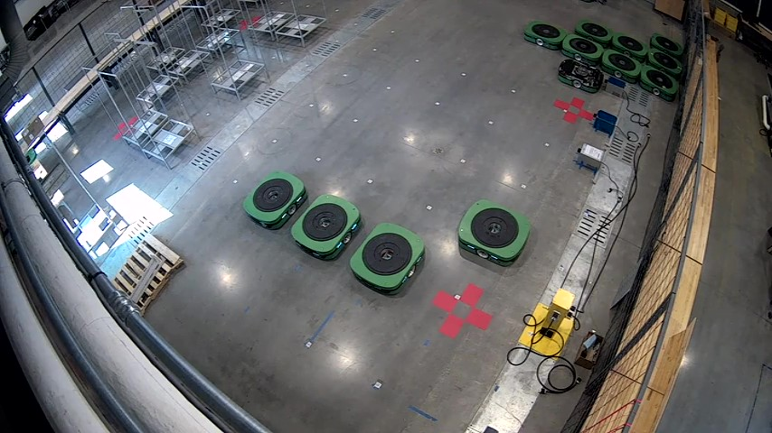
Our Digital Twin
Twin of Dr. Florin’s ROWS Robot Lab
Built model in Unreal Engine 5
Tour of the lab is at 3:30

Slide 4
What have we been working on?
Multi-Perspective Views
Object Detection Algorithms
Unreal Engine and Database Management
3D Modeling Technology

Slide 5
Creating a Top Down View
Takes in Security Camera footage
Manipulates that footage to create a top down view of the room
Fixes perspective issue from the security camera angle
Able to create the top down view frame by frame with live camera footage

Slide 6
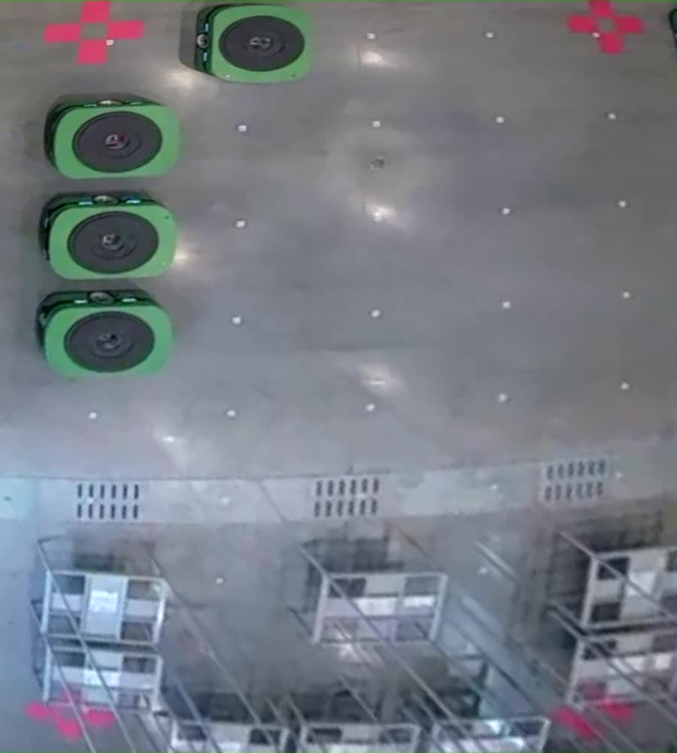

Slide 7
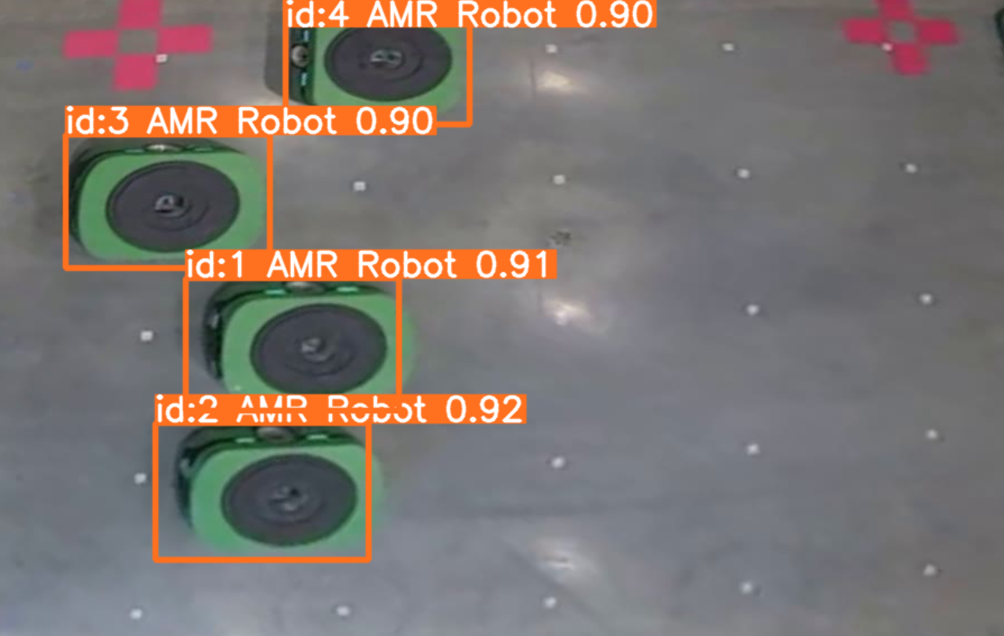
Object Detection
Uses You Only Look Once (YOLO) v8
Able to run on
Images
Pre-recorded Video
RTSP Security Camera Stream
Updates the robots positions within the database every frame
Average delay of 52ms

Slide 8
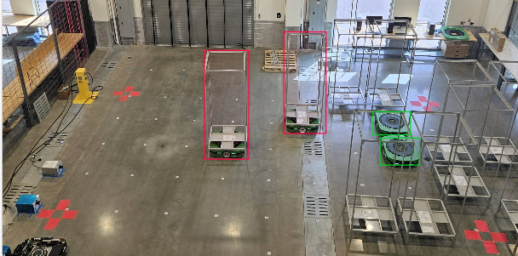
Training the YOLO Model
Photo annotation using CVAT.ai
Contains over 500 unique images
Trained / Retrained a total of 4 times
300 training cycles completed
Took over 30 hours to complete each training

Slide 9
Database Management
Need to get data from vision detection to Unreal
MongoDB is the database we decided to use
First step was getting C++ and python to connect to MongoDB
Getting Unreal to use the MongoDB Plugin was the next step

Slide 10
Unreal Engine and Our Database
Pixel Coordinates are translated to Unreal Coordinates
Unreal Coordinate = Scale * Pixel Coordinate - Offset
The object detector does this translation and then sends the coordinates to MongoDB
Along with a tag for what robot the coordinates relate to
Unreal Engine reads the database and updates each robots location

Slide 11
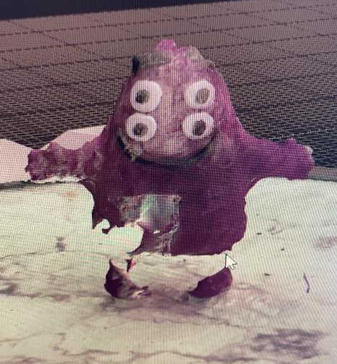
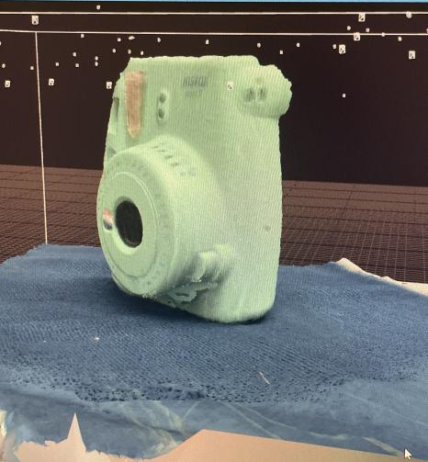
3D Modeling
Photogrammetry
Process of turning photos of an object into a 3D Model
More photos and angles leads to better results
Used Reality Capture initially to create models
Used LumaAI & Blender for final models for better results

Slide 12
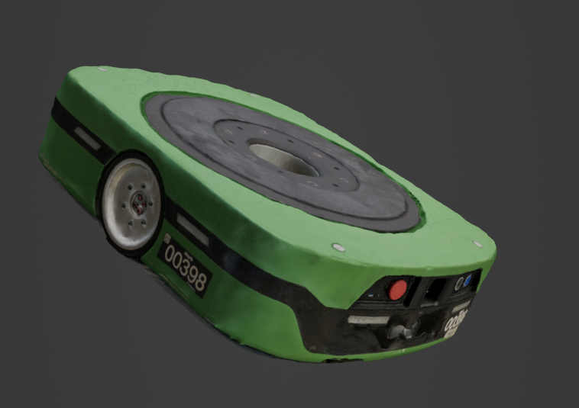
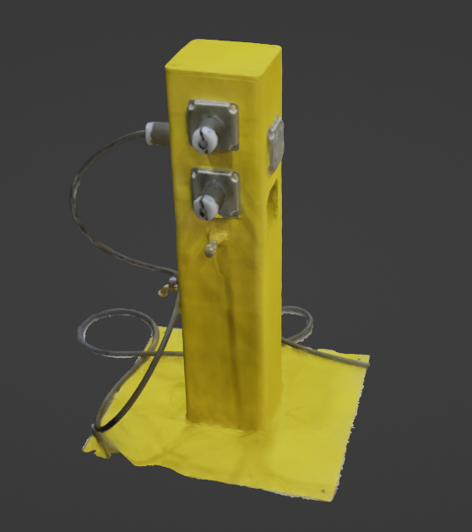
3D Models: Robot & Landmark

Slide 13
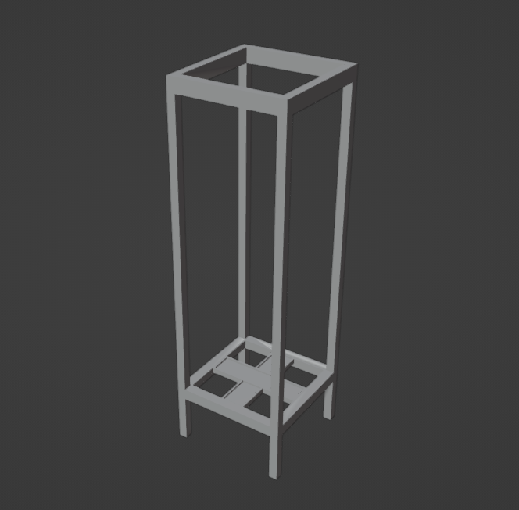
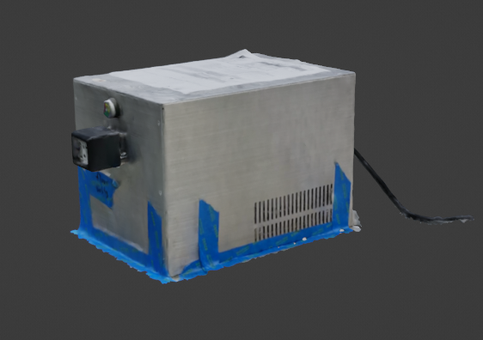
3D Models: Charging Station & Shelf

Slide 14
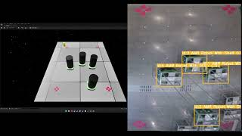
Final Product https://www.youtube.com/watch?v=KnP4f9_9hJw

Slide 15
Thank You!
Questions?

